Slide 1
AMA’s 2022 Program of Work
What is the AMA Program of Work (POW)?
Written plan of action created by the AMA staff and the Executive Council that gives a detailed description of the goals to be accomplish during 2022.
The POW’s plan is a set of related projects and activities, managed in a coordinated and collaborative fashion to deliver specific goals that provide benefits and services for AMA clubs, members, flying sites, and to advance AMA’s mission.

Slide 2
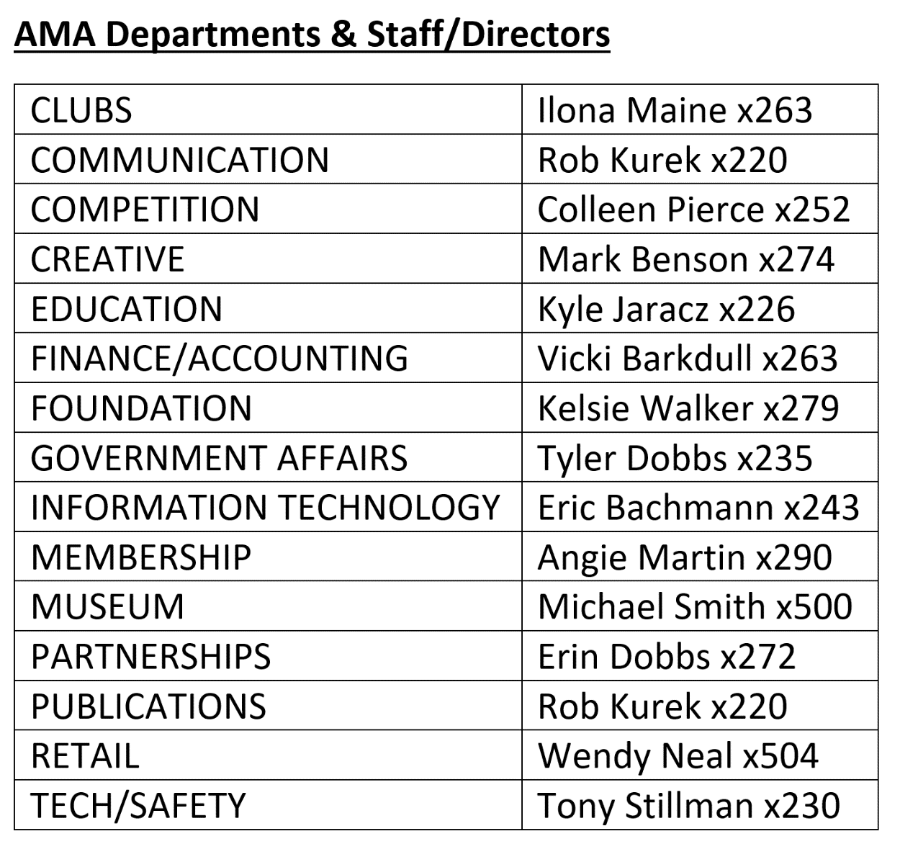
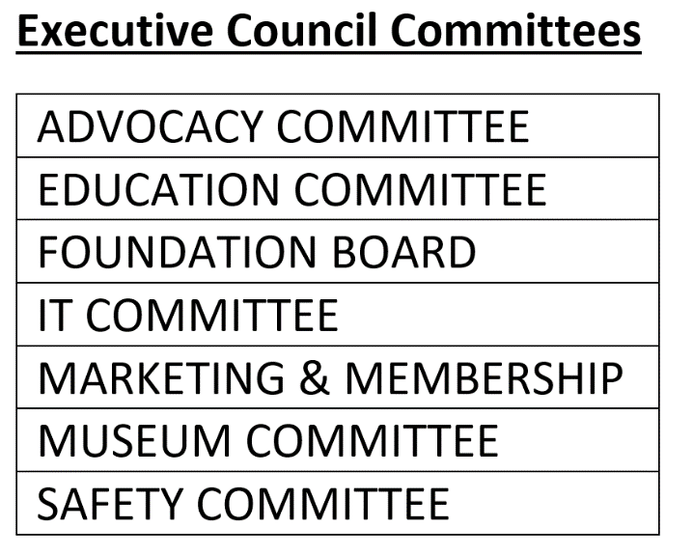
AMA’s 2022 Program of Work 3
How were the Goals and Objectives of the POW developed and determined?
Through a Collaborative effort of the Executive Council and some of its Committees, The AMA Staff and its 15 Departments and input from surveys in 2021 with AMA clubs and members.
AMA CLUBS AND MEMBERS
SURVEYED DURING 2021
COLLABORATIVE
EFFORT

Slide 3
AMA’s 2022 Program of Work (POW) 4
2. THEMES - There are three themes in the quarterly POW.
a) Invest in Clubs and Flying Site – “2022 the year of the club”
Add new club resources, benefits, and training.
Continue regulatory protections, altitude waivers, exemptions for TFRs, and Remote ID
Engage more with clubs on member growth and flying site assistance.
b) Invest in Members
Add new services, features, and benefits.
Improve HQ staff training and work flow to better serve members.
c) Increase Engagement
More strategic communications to members, clubs, and the public.
Additional crowdsourcing, member services, and customized user experiences.
Increase social media by 15% (likes followers, subscribers, mentions).

Slide 4
AMA’s 2022 Program of Work (POW) 5
1. First Quarter January – March
a) Launch AMA Digital Membership Cards
Emailed automatically from member database that can be printed or captured as an image on a smartphone (saving printing and mailing costs) A future QR code on cards can be scanned to verify membership, waivers, event registering, and to ID member event interest and location to later personalize email messaging to members.
b) Campaign SRM altitude victories
Tell how successful AMA has been in FAA SRMP in getting 100% of the altitudes requested for clubs and the mitigations that have influenced FAA decisions for granting the increased altitudes.
c) Improve and promote Life membership
Update $1,500 Life Membership program, to include review of benefits and more promotion.

Slide 5
AMA’s 2022 Program of Work (POW) 6
1. First Quarter January – March
d) Online portal for camping reservations
Members attending IAC for events will now find it much easier to request IAC campsites online then by phone or in person.
e) Campaign: Know Before You Fly; Annual/Ongoing
AMA along with other stakeholders is a contract partner in the KBYF program and does so to continue to demonstrate support of FAA’s KBYF sUAS safety objectives.
f) Campaign: Hearts and Minds; Annual/Ongoing
Utilize the “AMA Snapshots” tell the AMA story of influential members to win over the hearts and minds of our members.

Slide 6
AMA’s 2022 Program of Work (POW) 7
2. Second Quarter April – June
a) CBO Recognition
Make ready to apply for CBO status as prescribed in AC 91-57C. Another important step in the incremental process of UAS rule enactment
b) Improve club search engine
Enhance the club finder on the AMA website to better sort and filter clubs by STATE, leader club, intro pilot instructors, open/capped membership, types of aircraft flown as well as popular club events or activities and other important benefits.
c) EAA chapter and AMA club Young Eagle Build
After being stalled because of COVID its time to restart connecting EAA chapter’s Young Eagles to AMA’s Youth membership.
d) Campaign Membership acquisition with 3MT
In May offer free 3-month trial memberships and encourage clubs to offer a free club membership time for newbies and intro-pilot training

Slide 7
AMA’s 2022 Program of Work (POW) 8
2. Second Quarter April – June
e) Restructure Newsletters and E-Communications
Streamline the newsletter and email member engagement, consolidate AMA Today,
Rotor Report, and Media Minute into “AMA This Week”.
f) Campaign: Why Your Local Group Should Charter as an AMA Club
Create messaging that highlights the benefits of being an AMA chartered club.
g) Scope Walk of Fame Foundation Campaign
Consider costs in creating a virtual tour, online brick locator, and on-site kiosk/signage. Develop materials for major gift prospects with public campaign in 2023

Slide 8
AMA’s 2022 Program of Work (POW) 9
3 Third Quarter July – September
a) Assist and train club officers through email journey
Create content (video/written w/graphics) for club officer monthly emails with AMA/club business-related matters.
b) Dynamic and personalized member content
Use member profile data to create personalized content blocks within “AMA This Week” based on member preferences, location, and interests.
c) Re-boarding member email journey
Continuation of 2021. Provide needed updates to current member journeys.
d) Launch club toolkit
Put together resources for club tool kit by 2Q22. Collaborate with other dept. for
additional resources work with Creative and Communications in 3Q22 to compile,
design, and distribute.

Slide 9
AMA’s 2022 Program of Work (POW) 10
4. Fourth Quarter October – December
a) Military recognition and honor
Explore options to honor our military and veterans through thank-you and
benefits.
b) Launch online club charter renewal
Plan and set milestones for online club charter renewal with IT by 1Q22.
Have functioning club charter renewal ready by mid-September 2022 and for club
officers to test starting in October 2022. Have a live platform mid November 2022.
c) Improve and expand flying site services
Review flying site assistance material by end of 2Q22. Collaborate with Creative for branding updates and new creative material by end of 3Q22.
Work with IT to update website by end of 4Q22.

Slide 10
AMA’s 2022 Program of Work (POW) 11
4. Fourth Quarter October – December
d) Remote-ID FRIA application
Work with FAA, staff, clubs, and AMA leadership to coordinate efforts to secure Remote-ID FRIA status for AMA’s fixed flying sites.
e) Museum virtual tour
New local vendor with IT in 2021-2022. Shoot new gallery photos and upload to new virtual tour online by 4Q22.
f) Redesign AMA Flight School with basic LMS
Create an AMA Flight School experience with new Learning Management System (LMS) Elements with easy access to varied training modules. Have IT and Creative departments, consider utilizing a WordPress Theme.

Slide 11
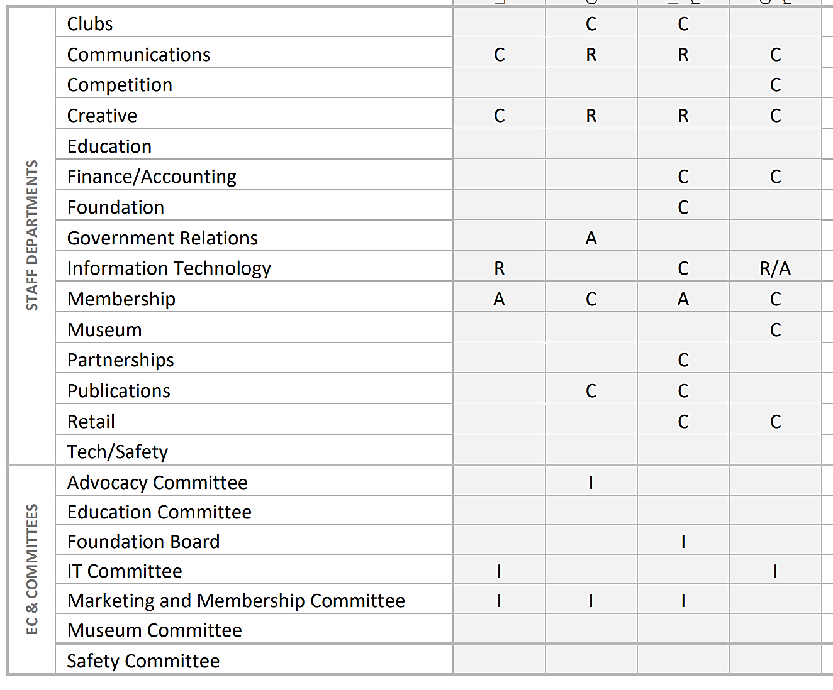
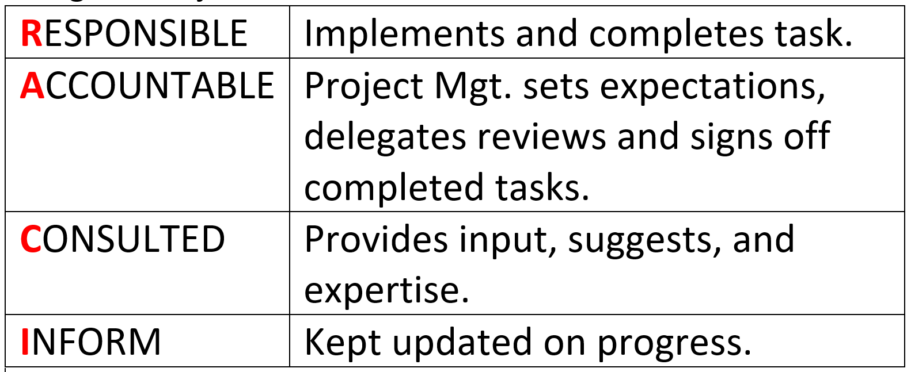
AMA’s 2022 Program of Work
1. First Quarter January – March
d) Online portal for camping reservations
c) Improve/promote life membership
b) Campaign SRM altitude victories
a) Launch Digital Membership Cards
RACI MATRIX describes the various roles by staff and council to complete POW initiatives, and goals or objectives.

Slide 12
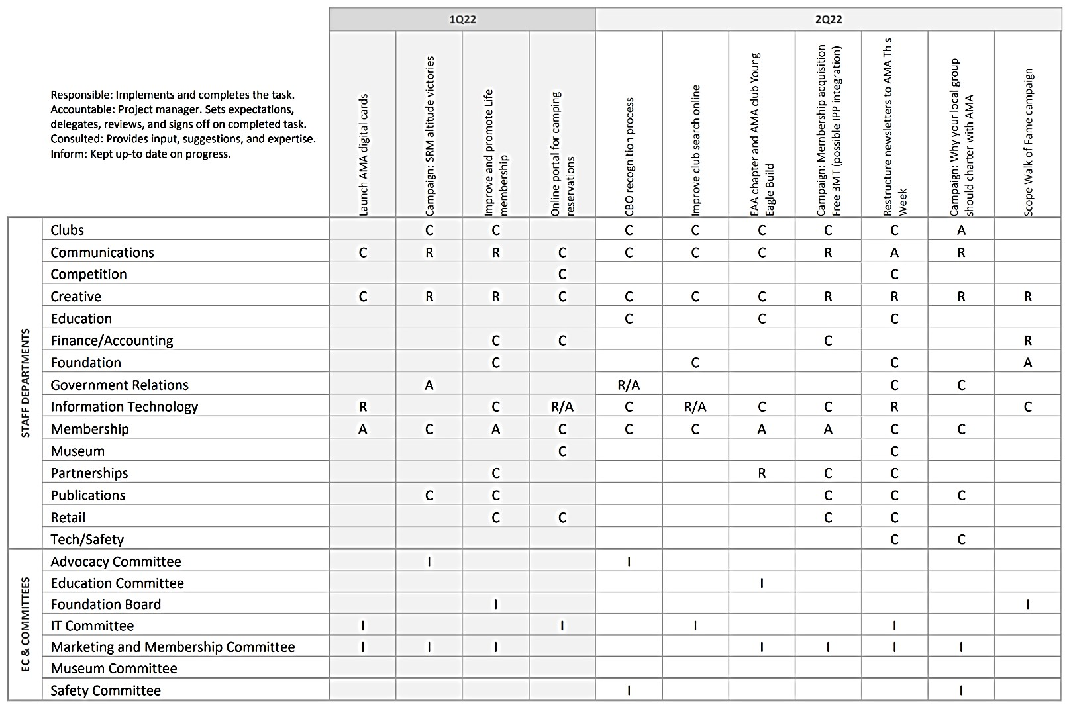
AMA’s 2022 Program of Work (POW)
RACI MATRIX CHART #1
Identifies various roles of staff, committees, and council to complete the POW initiatives/tasks.
RACI Project Management:
►(R) Responsible: Implements and completes the task.
►(A) Accountable: Project manager. Sets expectations, delegates, reviews, and signs off on completed task.
►(C) Consulted: Provides input, suggestions, and expertise.
►(I) Inform: Kept up-to date on progress.

Slide 13
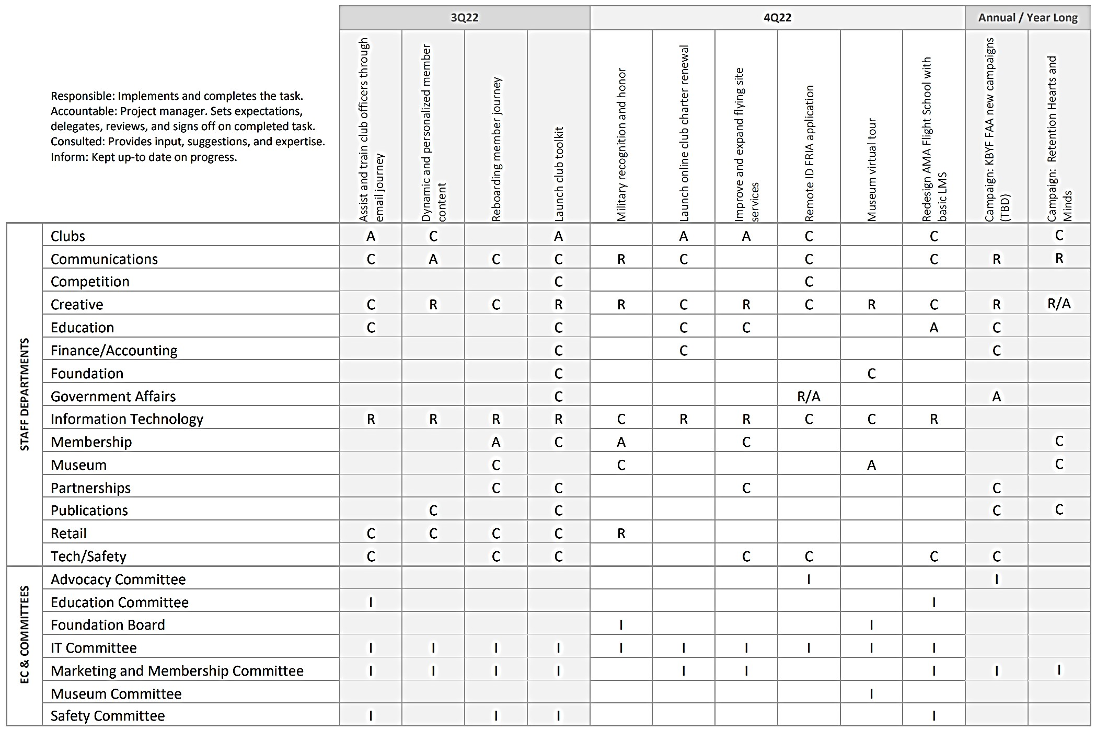
AMA’s 2022 Program of Work (POW)
RACI MATRIX CHART #2
Identifies various roles of staff, committees, and council to complete the POW initiatives/tasks.
RACI Project Management:
►(R) Responsible: Implements and completes the task.
►(A) Accountable: Project manager. Sets expectations, delegates, reviews, and signs off on completed task.
►(C) Consulted: Provides input, suggestions, and expertise.
►(I) Inform: Kept up-to date on progress.

Slide 14
Summary AMA’s 2022 Program of Work
1. First Quarter January – March
Launch AMA Digital Membership Cards.
Campaign SRM altitude victories.
Improve and promote Life membership
Online portal for camping reservations.
2. Second Quarter April – June
CBO Recognition.
Improve club search engine.
EAA chapter and AMA club Young Eagle Build.
Campaign Membership acquisition
Free 3MT
3. Third Quarter July – September
Assist & Train club officers through email journey.
Dynamic personalized member content.
Re-boarding member journey.
Launch club toolkit.
4. Fourth Quarter October – December
Military recognition and honor.
Launch online club charter renewal.
Improve and expand flying site services.
Remote-ID FRIA application.
Museum virtual tour.
Redesign Flight School with basic LMS.

Slide 15
AMA
COMPLETED

