Slide 1
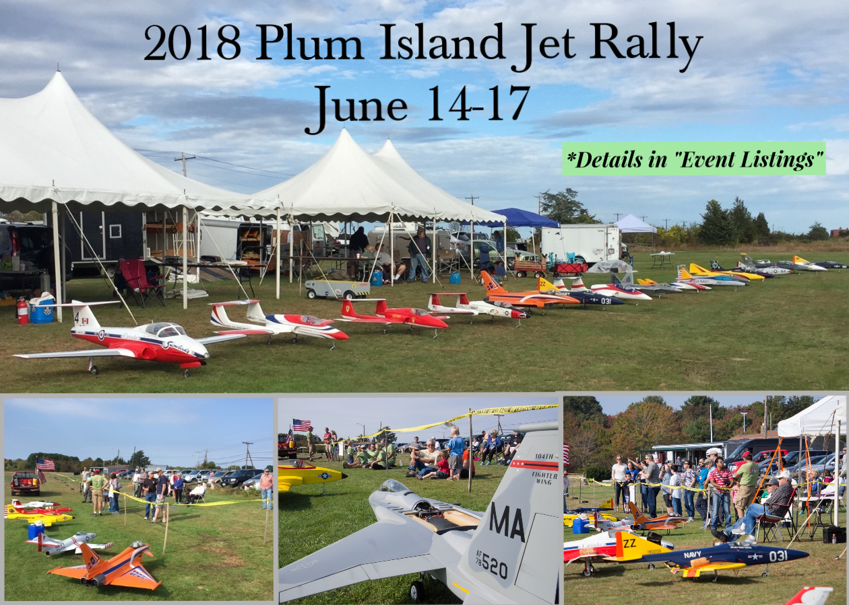
EVENT SEASON!
CDs/ EMs or anyone interested in learning more about
the AMA Contest/ Event Package (Form 10)
Let’s “Ask the AVP?”

Slide 2
“ASK THE AVP?” (AVP- AMA Assoc. VP)
An informal grass roots initiative of District 1 to:
Showcase Clubs, Events, Activities, and Members
Discuss AMA Information & Programs
Address technical and product questions

Slide 3
Let’s take a closer look at the
AMA Document Form 10
THE CONTEST/ EVENT PACKAGE
Before we get into the package let’s go check out the AMA Sanction Portal to see where we: Create, Renew, or View Sanctions. Once that is complete you will be sent your paperwork via email which includes a link to the
Form 10- Contest/ Event Package. www.modelaircraft.org

Slide 4
Submission of the form by the CD/EM is necessary for compliance with insurance requirements. This information can aid in promotion of future events PAGE 1and settlement of any event problems. The CD/EM must return this form within seven (7) days to AMA Headquarters attached to Form 10. Last updated 6.14.2019

Slide 5
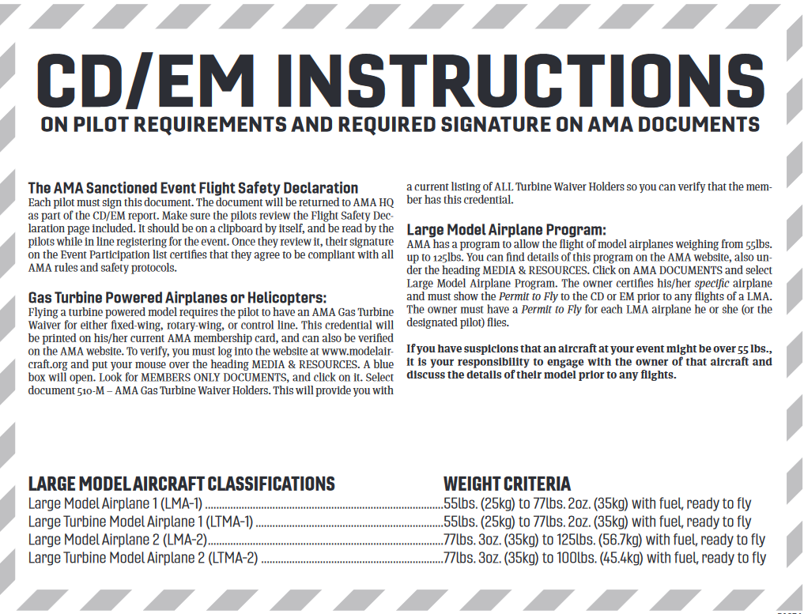
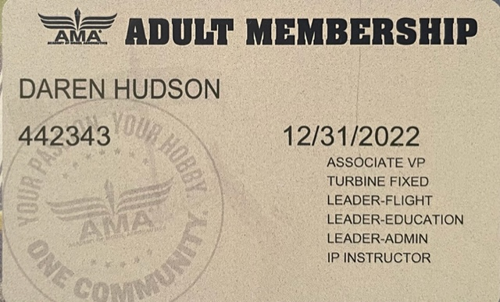
If flying a model between 55lbs. up to 125lbs. Details under Large Model Airplane Program (LMA). Log into www.modelaircraft.org MEDIA & RESOURCES/ AMA DOCUMENTS/ LARGE MODEL AIRPLANE PROGRAM.
The owner certifies his/her specific airplane and must show the Permit to Fly to the CD or EM prior to any flights of a LMA. The owner must have a Permit to Fly for each LMA airplane he or she (or the designated pilot) flies.
If you have suspicions that an aircraft at your event might be over 55 lbs., it is your responsibility to engage with the owner of that aircraft and discuss the details of their model prior to any flights.
Each pilot must sign this document- the Flight Safety Declaration (sign in sheet).
Pilot Requirement Page (7 Bulleted Requirements) should be accessible to all pilots to read at or before registration.
Once they review it, their signature on the Flight Safety Declaration (sign in sheet) certifies that they agree to be compliant with all AMA rules and safety protocols.
Flying a turbine powered model requires the pilot to have an AMA Gas Turbine Waiver for either fixed-wing, rotary-wing, or control line. This credential will be printed on his/her current AMA membership card, and can also be verified on the AMA website.
To verify, log into the website at www.modelaircraft.org MEDIA & RESOURCES/ AMA DOCUMENTS/ Document 510-M – “AMA Gas Turbine Waiver Holders”.

Slide 6
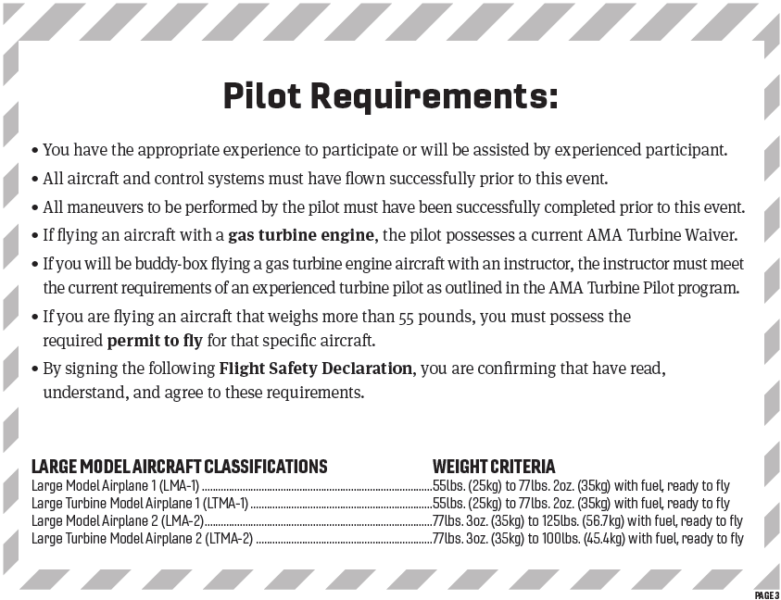
* This is a common misinterpretation among many turbine waiver pilots. From the Gas Turbine Program Document 510 A:
22. An experienced turbine pilot is defined as a pilot who has completed 20 or more turbine flights during the preceding 24 months and who has a turbine waiver issued by AMA. For confirmation purposes, the pilot is required to keep a written log of all flights and will provide copies to AMA upon request. Experienced turbine pilots may:
a. Provide turbine-powered model flight instruction (using a buddy box) to non-waiver holder AMA pilots;
b. Conduct turbine waiver qualification flights and sign the turbine waiver application (AMA document 510d)
c. Supervise the first five solo turbine flights of a newly-waived turbine pilot.
23. Waivered pilots who do not meet this experience requirement can obtain/regain experienced status by performing the 20 or more turbine flights in the current 24-month continuous period; it is not necessary to reapply for a turbine waiver or re-perform a turbine waiver qualification flight.
Share some examples: ETP no log or log shows < 20flts/ 24 mo.? See section 23 above.
CD not familiar with waiver holder or their proficiency? Refer to Bullets 1-3, ask for a reference, monitor first flight. The signed Flight Safety Declaration is the pilot’s confirmation and their responsibility.
ALL PILOTS Must Read and understand their responsibilities.
Designed to be easily read while at a registration table.
This is the agreement you are signing.
This is what CDs and EMs and their designees will hold pilots accountable to at the event!
PLEASE READ IT!

Slide 7
Let’s practice navigating to the DOCUMENTS section using:
The AMA website- www.modelaircraft.org and The District 1 website- www.amadistrict-i.org
We’ll take a look at:
The Form 10, Contest/ Event Package
The Large Model Airplane Document 520 A, Permit Holder List, and LMA Inspector List
The Gas Turbine Waiver Program Documents- 510 A, 510 D, and Waiver Holder List

Slide 8
Consider a Pilot Briefing Checklist for CDs/ EMs at Pilot Meetings.
Events may require venue specific details to be covered in the Pilot Meeting.
Having a script will allow all pertinent information to be covered.
CDs/ EMs may want to create additional requirements for their specific events. Advance notice to participants is highly recommended.
The more clearly defined your expectations are at the start of your event the less chance for confusion or conflicts!
*Depending on the nature of the event consider short Q&A or review of: The Gas Turbine Waiver Program or the LMA- Large Model Airplane Program or other pertinent information.

Slide 9
SUMMARY
The Form 10 or Contest/ Event Package is an INSURANCE requirement.
ALL participants are required to READ AND UNDERSTAND the PILOT REQUIREMENTS sheet for their responsibilities prior to signing the FLIGHT SAFETY DECLARATION.
The AMA safety programming, Safety Code and The Contest/ Event Package procedures provided, under the approval of the insurance company AND the FAA, the ability to fly at events with models up to 55# and also:
Turbine Powered Aircraft
Large Model Airplanes (over 55# up to 125#)
AMA designated CDs- Contest Directors and EMs- Event Managers are responsible for the operation and compliance of this programming and are the ultimate authority at events.
AMA members are responsible for compliance with the requirements for their particular operation of model aircraft.
The CDs/ EMs and any AMA district representatives are charged with finding a balance between fun and safety while offering guidance to CDs/ EMs and members at events. This is much like the FAA and it’s authority over airshow operations, balancing safety and promotion. The CDs/ EMs and their designees, such as Air Bosses are the ultimate authority at events and the participants are expected to respect them.
By becoming more familiar with the AMA safety mitigation programming our entire aeromodelling community can maintain the stellar safety record and reputation of AMA in the eyes of those agencies keeping a closer watch on our activities. Compliance to the safety programming while having a good time is crucial.

Slide 10
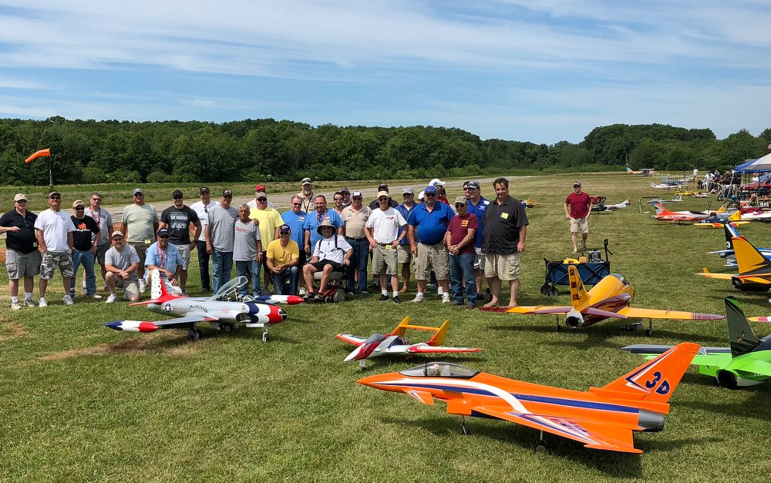
The End!
Enjoy your Events
Links will be provided in the video description. Thank you.

